Slide 1




Rockbuster Stealth
Launch strategy for a rockbuster online video service

Slide 2
Key Business Questions
What was the average rental duration for all videos?
Do sales figures vary between geographic regions?
Where are customers with a high lifetime value based?
Which countries are Rockbuster customers based in?
Which movies contributed the most/least to revenue gain?

Slide 3








Current Rental Key Statistics
Rockbuster Movie rentals around the world in 2019
Key statistical indicators for the world of movie rentals
Avg.
Rental Duration
Active Customers
Avg.
Rental Rate
Avg.
Film Length
Countries
Store Fronts
Films
599
108
2
1000
$2.98
115 min
5 Days

Slide 4

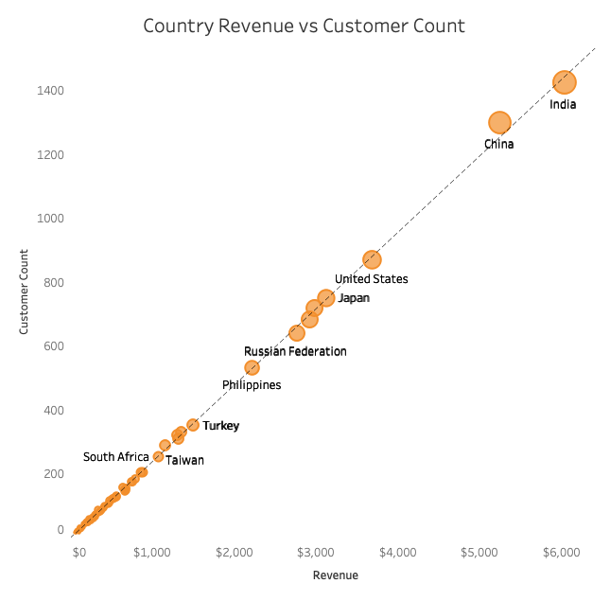
Customer Distribution
Top 10 countries and cities for Rockbuster in terms of customer numbers:
India
Ambattur
China
Shanwei
Tianjin
United States
Aurora
Citrus Heights
Japan
Iwaki
Mexico
Acua
Brazil
So Leopoldo
Russian Federation
Teboksary
Philippines
Turkey
Indonesia
Cianjur

Slide 5

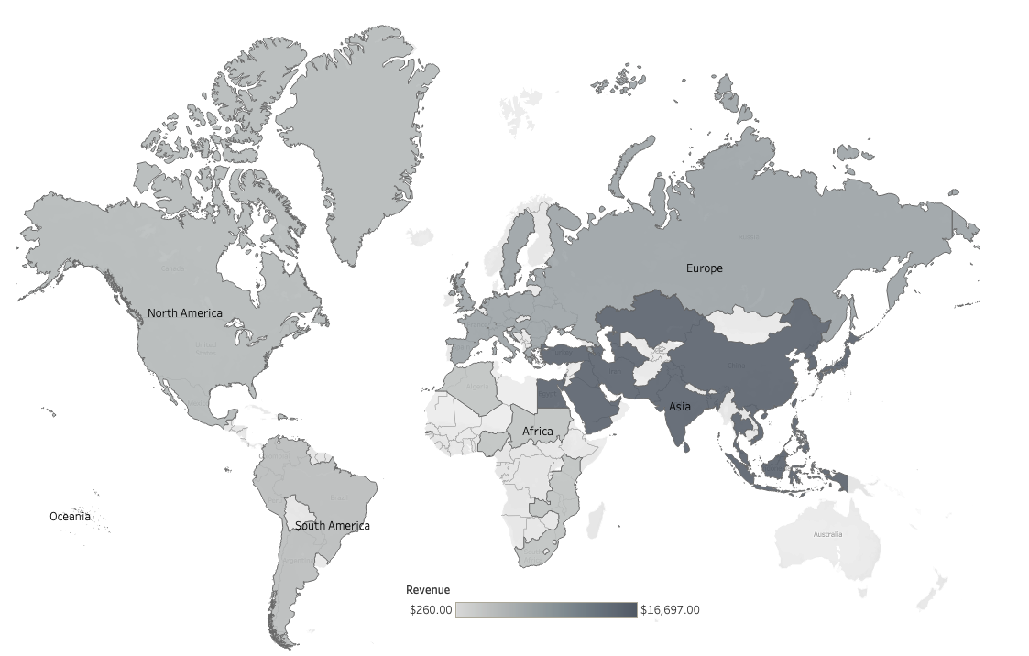
Revenue By Continent
Asia - $16.697
Europe - $7,259
North America $4,258
South America - $3,701
Africa - $2,985
Oceania - $260

Slide 6

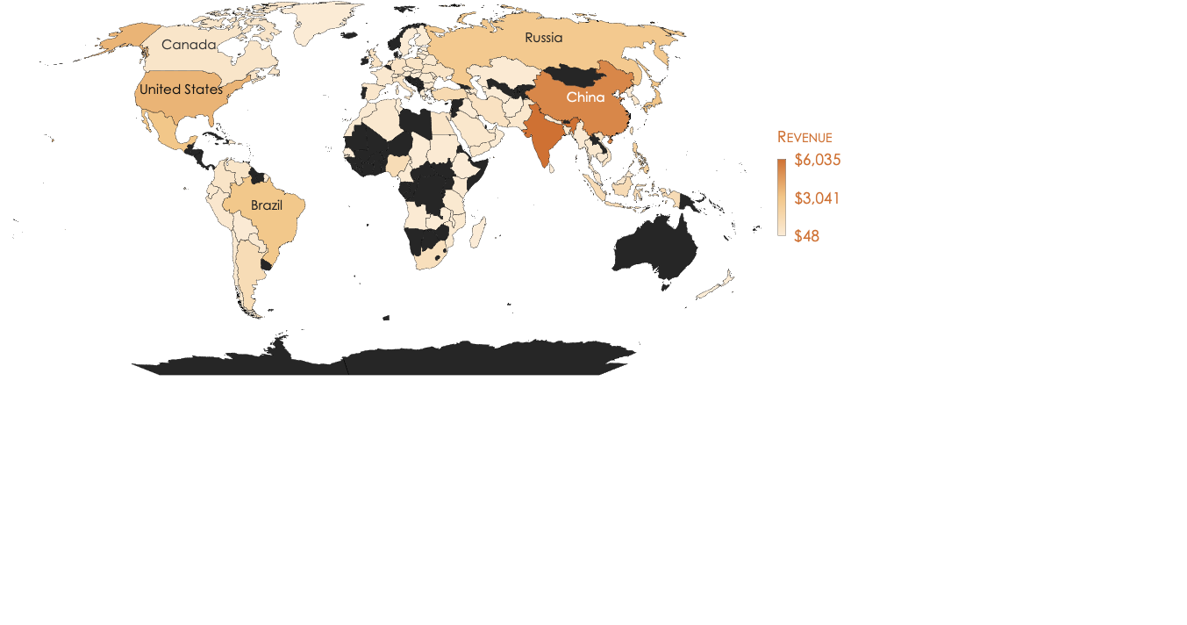
Revenue per Country

Slide 7

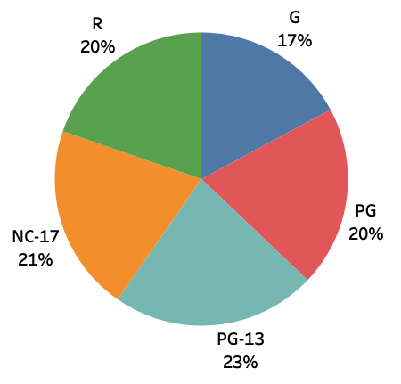
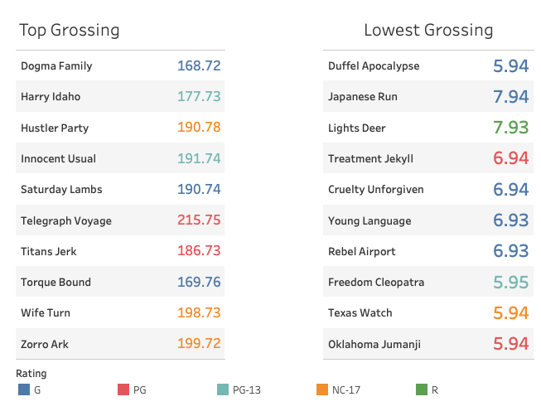
Film Revenue
Revenue Per Category
There is a relatively even distribution of revenue being generated per rating category.

Slide 8

Primary Revenue Products

Slide 9






Primary Revenue Customers
Customer 1
$212
Customer 2
$209
Customer 3
$195
Customer 4
$192
As you can see there is no correlation between geographic regions and top revenue generating customers.
Customer 5
$190

Slide 10
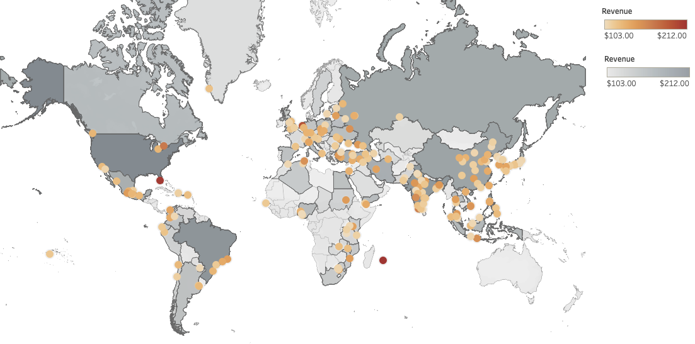
Customer Lifetime Value
$102.35
=
$4.2
X
24.37
X
1yr
Customer Lifetime Value
Average Order Value
Average # of Transactions
Average Customer life span

Slide 11

Insights and Recommendations
We can see a strong correlation between customer count and country revenue. Before using these insights to roll out a new strategy the data should be further analyzed against regional internet services/ customer access to see how these results could be affected by a lack of resources.
Rockbusters current customer lifetime value is $102.35 with the high value customers mainly dispersed throughout Asia and Europe, although, the top primary revenue generating customers are not concentrated in any specific country or region.
There is low variability in how much a film generates based on rating, however, certain genres produce more that others with sports and sci-fi being the highest and thrillers being well below music which is the next lowest revenue generating genre.

